Slide 1
Portable Extinguishers Firefighter I
North Carolina Fire & Rescue Commission
Portable Extinguishers

Slide 2
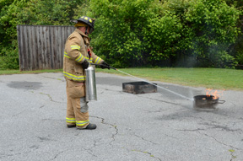
Lesson One Firefighter I
TERMINAL OBJECTIVE
The Firefighter I candidate shall identify in writing the classifications of fire as they relate to the use of fire extinguishers, define the fire extinguisher rating systems, identify the appropriate extinguisher and application procedures, and correctly demonstrate extinguishing Class A and B fires by using appropriate portable fire extinguishers.

Slide 3
Enabling Objectives
The Firefighter I candidate, when given a fire scenario, shall correctly identify each of the five classes of fire and the appropriate type of fire extinguisher to use on each class.
The Firefighter I candidate shall correctly identify, verbally and in writing, the ratings of any given portable fire extinguisher.

Slide 4
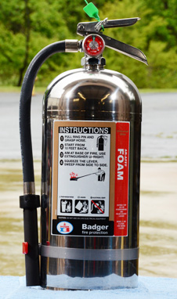
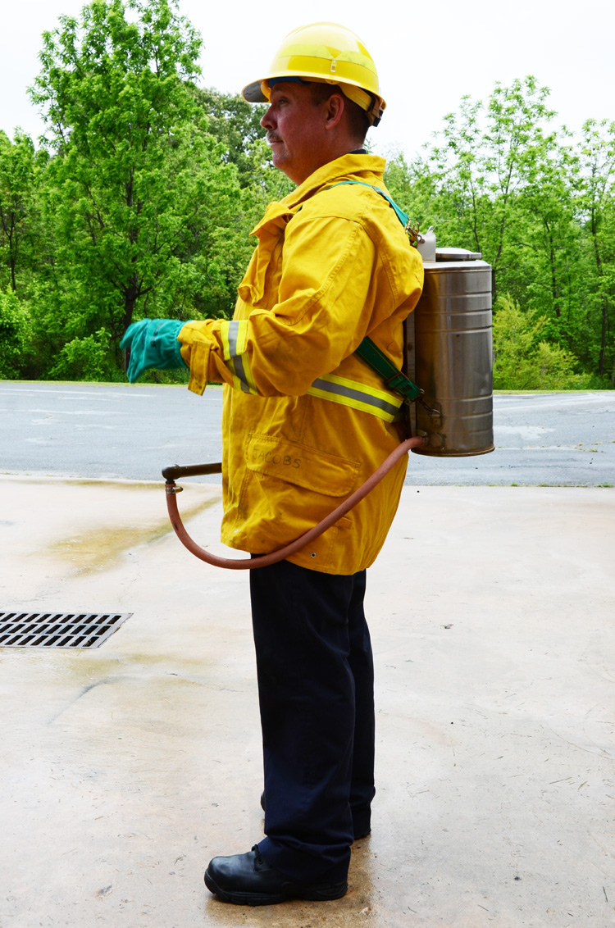
Enabling Objectives
The Firefighter I candidate shall correctly identify, verbally and in writing, the different types of fire extinguishers and the agents used in each.

Slide 5
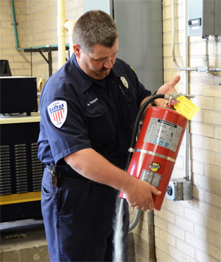
Enabling Objectives
The Firefighter I candidate shall visually, verbally, and by physical demonstration correctly inspect portable fire extinguishers and determine proper working order and placement.

Slide 6
Enabling Objectives
The Firefighter I candidate shall correctly list in writing the proper maintenance requirements and hydrostatic testing procedures for portable fire extinguishers.
The Firefighter I candidate shall correctly identify in writing the steps for selecting the appropriate portable fire extinguisher, and demonstrate the use of extinguishers on Class A and B fires.

Slide 7
Classes Of Fire
Five Classes of fire
Class A: ordinary combustibles
Class B: flammable and combustible liquids, gases, and greases
Class C: fires that are created from electrical energy
Class D: combustible metals and alloys
Class K: combustible cooking oils

Slide 8
Classes Of Fire
Class A: ordinary combustibles
Textiles, paper, plastics, rubber, wood
Class B: flammable and combustible liquids, gases, and greases
Alcohol, cooking oils, gasoline, LPG
Class C: fires that are created from electrical energy
Class D: combustible metals and alloys
Lithium, magnesium, potassium, sodium
Class K: combustible cooking oils
Vegetable and animal fats and oils

Slide 9
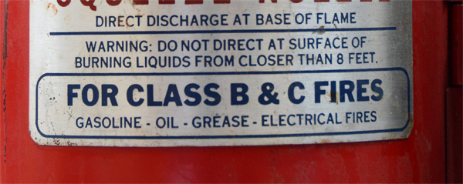
Classes Of Fire
Class A: ordinary combustibles
Water, foam, dry chemicals
Class B: flammable and combustible liquids, gases, and greases
CO₂, class B foam, dry chemical
Class C: fires that are created from electrical energy
Eliminate the electrical energy

Slide 10
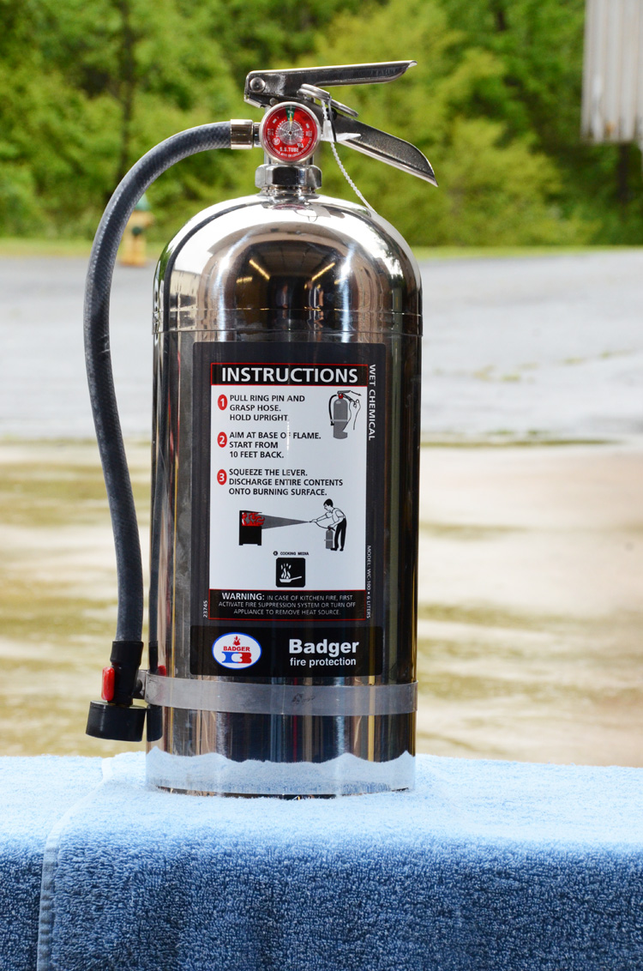
Classes Of Fire
Class D: combustible metals and alloys
Dry powder extinguishers
Class K: combustible cooking oils
Wet chemical extinguishers

Slide 11
Extinguisher Ratings
Extinguisher ratings define the extinguishing capability for each size and type of portable extinguisher.
They are rated according to the type of fire they can extinguish
The number represents their performance capability

Slide 12
Extinguisher Ratings
Class A ratings: 1-A through 40-A
Class B ratings: 1-B through 640-B
Class C ratings: No numerical rating. Nonconductive agent
Class D ratings: No numerical rating. Tested for reactivity and toxicity
Class K ratings: Agents capable of converting fatty acids to a soap or foam. Minimum criteria extinguishes a surface area of 2.25 sq. ft.

Slide 13
Extinguisher Ratings
Multiple markings
Suitable for extinguishing more than one class of fire and are identified by a combination of letters

Slide 14
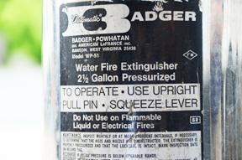
Extinguisher Ratings
Class A ratings: 1-A - 1 ¼ gal (5L) of water
Class B ratings: 1-B - extinguish 1 sq. ft. of area
Class C ratings: No numerical rating

Slide 15
Extinguisher Ratings
Class D ratings: No numerical rating.
Class K ratings: No numerical rating. Minimum criteria extinguishes a surface area of 2.25 sq. ft.

Slide 16
Extinguisher Ratings
Pump-type water extinguishers
Class A
Stored pressure water extinguishers
Class A
Water-mist stored pressure extinguishers
Class A
Class C
Aqueous film forming foam (AFFF) extinguishers
Class A
Class B

Slide 17
Extinguisher Ratings
Clean agent extinguishers
Class A
Class B
Class C
Carbon dioxide extinguishers
Class B
Class C
Wet chemical stored-pressure extinguishers
Class K

Slide 18
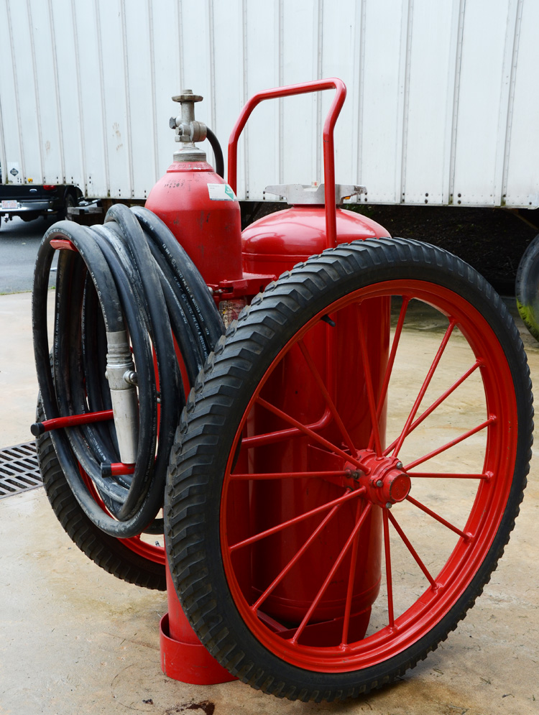
Extinguisher Ratings
Dry chemical extinguishers
Class A
Class B
Class C
Wheeled dry chemical extinguisher

Slide 19
Extinguisher Ratings
Dry powders
Class D
Class D extinguishers
No single agent will extinguish fires in all combustible metals

Slide 20
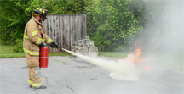
Extinguisher Selection
Class of burning fuel
Rating of extinguisher
Exposures to protect
Size and intensity of fire
Surrounding conditions
Ease of extinguisher handling
Personnel training

Slide 21
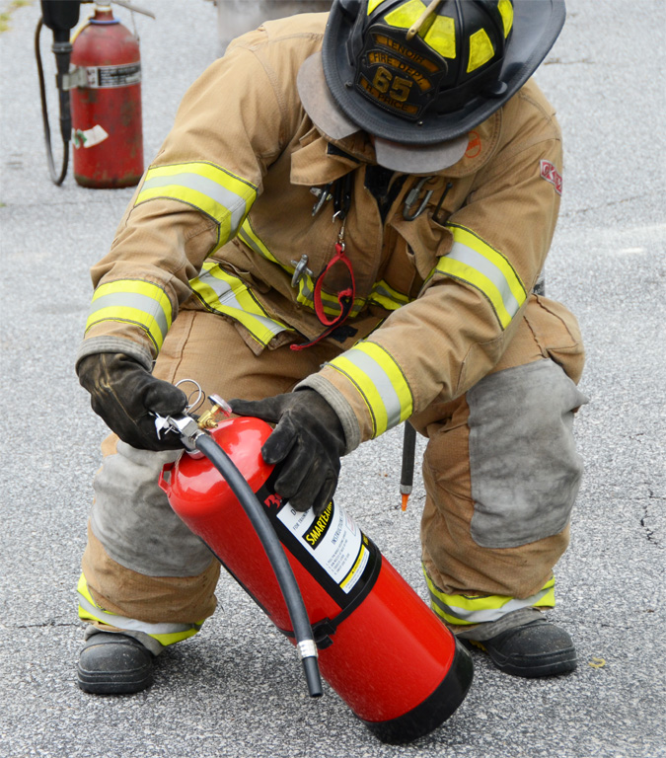
Extinguisher Application
Select size and type
Check the extinguisher
Condition of container and nozzle
Weight
Pressure gauge
Approach from the
windward side

Slide 22
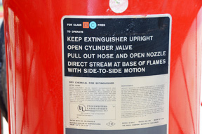
Extinguisher Application
PASS Method of application
P: Pull the pin
A: Aim the nozzle
S: Squeeze the handles together
S: Sweep the nozzle back and forth

Slide 23
Extinguisher Protection
NFPA 10, 2010 edition
Standard For Portable Fire Extinguishers
Fire extinguishers shall not be exposed to temperatures outside the listed temperature range shown on the extinguisher label
Fire extinguishers containing only water shall be protected to temperatures as low as -40⁰F by the addition of an antifreeze that is stipulated on the fire extinguisher nameplate

Slide 24
Extinguisher Protection
Calcium chloride solutions shall not be used in stainless steel fire extinguishers

Slide 25
Extinguisher Service &Inspection
Inspect at least once each year to ensure accessibility and operability
They must be in their designated locations
Ensure they have not been activated or tampered with
Check for physical signs of damage
Servicing is done by a fire extinguisher professional

Slide 26
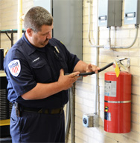
Extinguisher Inspection
Inspections
Inspect at least once each year to ensure it is accessible and in the proper location
Check nozzle or horn for obstructions or damage

Slide 27
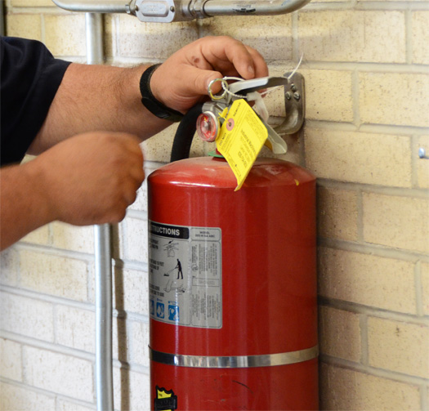
Extinguisher Inspection
Inspections
Check the the shell for damage
Operating instructions are legible
Check the locking pin and tamper seal are in place
Check that the extinguisher is full of agent

Slide 28
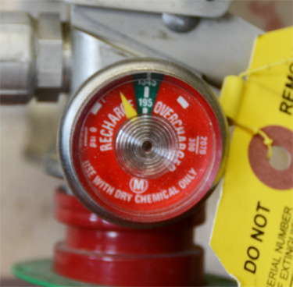
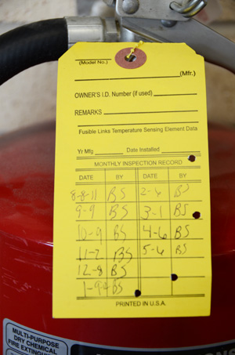
Extinguisher Inspection
Inspections
Check that the extinguisher is full of agent
By pressure gauge
By weight
By agent level
Check inspection tag
Date of last inspection
Maintenance
Recharging
Examine hose and fittings

Slide 29
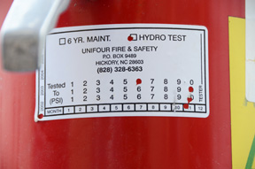
Extinguisher Hydrostatic Testing
NFPA 10, 2010 edition
Standard For Portable Fire Extinguishers
Test results should be fixed to the can

Slide 30
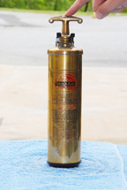
Obsolete Extinguishers
Inverting type fire extinguishers
Soda-acid
Foam
Internal cartridge-operated water and loaded stream
Internal cartridge dry-chemical

Slide 31
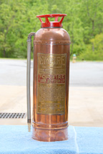
Obsolete Extinguishers
Soft soldered or riveted copper or brass cylinders

Slide 32
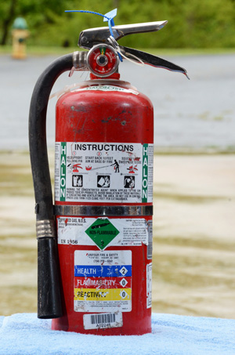
Obsolete Extinguishers
Carbon tetrachloride or chlorobromomethane
Halon
Halon 1211
Halon 1301

Slide 33
Summary
Review the five classes of fire and the type of portable fire extinguisher to be used on each class of fire. Summarize the ratings and sizes of each type of extinguisher and how the ratings are determined.
Review the marking systems used on extinguishers and the various different agents used.

Slide 34
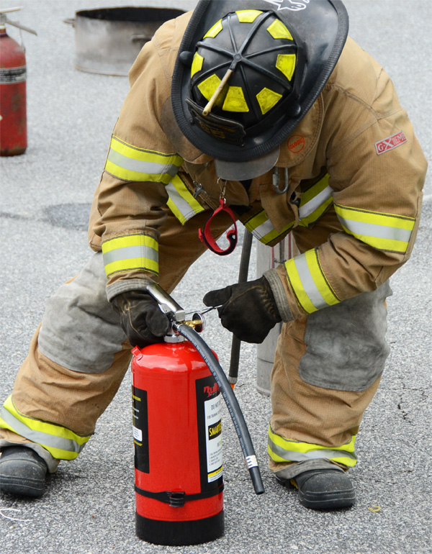
Summary
Review inspection procedures and hydrostatic testing.
Summarize the operational methods for each fire extinguisher.

