Slide 1
Orientation & Safety
Firefighter II
North Carolina Fire & Rescue Commission
Orientation & Safety
Updated 12/2011

Slide 2
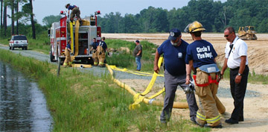
Lesson One Firefighter II
TERMINAL OBJECTIVE
The Firefighter II candidate shall correctly describe their role within the organization as it relates to their job in emergency and non-emergency situations.

Slide 3
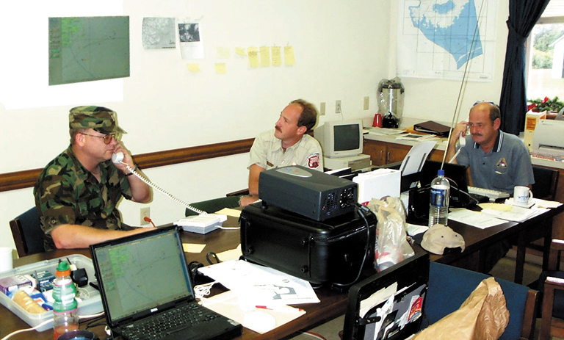
Enabling Objectives
The Firefighter II candidate shall correctly define in writing their role within the fire department .
The Firefighter II candidate shall correctly define in writing the responsibilities of assuming and transferring command within the Incident Command System .

Slide 4
Firefighter II Role
The “Role” refers to an expected behavior in all types of pertinent situations with the associated expected results.
The Role of the FF II can be broken down into two distinct categories:
  Non-combative
  Combative

Slide 5
Non-Combative Role
Exhibit leadership in the performance of any duty assignment.
Exhibit a thorough knowledge of S.O.P.s, Rules and Regulations.
Maintenance of equipment.
Maintenance of quarters (station).
Maintenance of physical abilities.

Slide 6
Non-Combative Role
Awareness of safety in performance of all duties
Take on additional responsibility of higher rank when required.
Perform fire inspections within the jurisdiction.
Train in accordance with required standards to a high degree of proficiency.
Strive to maintain the professional image of the fire service when dealing with citizens.

Slide 7
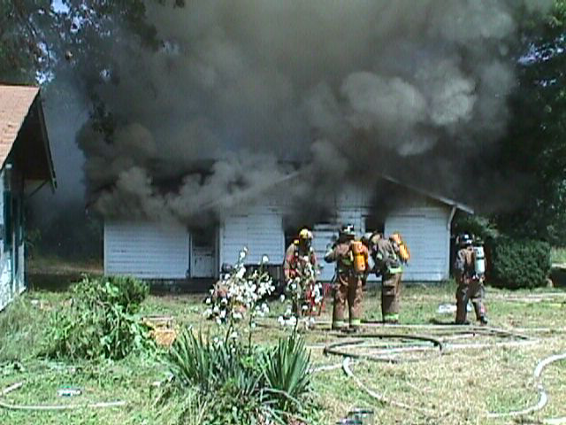
Combative Role
  They must execute all orders in a timely and precise fashion.
  Explanation of procedures and methods should be unnecessary.
  When required, a Firefighter II must be capable of assuming command of an operation until higher-ranking personnel are available.

Slide 8
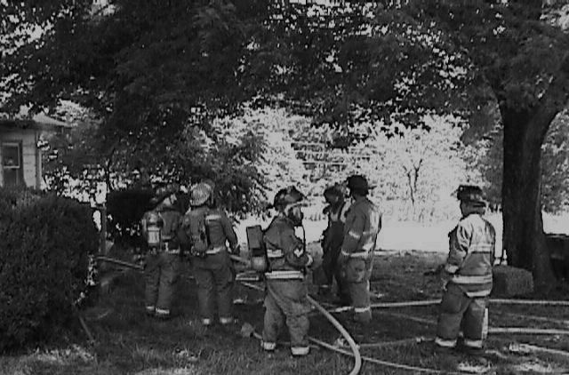


Combative Role
Incident capabilities include:
  Respond to alarms in accordance with S.O.P.s, Rules and Regulations.
  Perform required fire ground function efficiently and safely.
  Assume and transfer command when necessary
  Relay any necessary information, and give location of alarms received from dispatch.
  Protect life and property to the highest degree possible.
  Perform to the highest levels of professionalism.

Slide 9
Transfer of Command
In order to assume command of an incident, the Firefighter II must first understand the responsibilities of the command position.
  Assesses the incident priorities.
  Determines the incident’s strategic goals and tactical objectives.
  Develops or approves and implements the incident action plan.
  Develops an incident command structure appropriate for the incident.

Slide 10
Transfer of Command
Responsibilities of the command position:
  Assesses resource needs and orders, deploys, and releases needed resources.
  Coordinates overall emergency activities.
  Serves as the ultimate safety officer responsible for preventing fire fighter injuries and/or death.
  Coordinates activities of outside agencies.
  Authorizes information release to the media.

Slide 11
Transfer of Command
Transfer of command is a critical function that must be accomplished efficiently and accurately.
The general steps for transferring command include:
  Upon arrival of the higher-ranking officer the transfer of command will begin.
  Describe what has happened.

Slide 12
Transfer of Command
Transfer of command steps:
  Whether anyone was / is injured or trapped.
  Whether the problem is stabilized or getting worse.
  What resources are on scene or en-route.
  Whether current resources are adequate for the situation or that more resources need to be called.
  The Firefighter II will then listen to the new IC repeat the status report to identify any miscommunication.

Slide 13
Review
Review the fact that the Firefighter II should be able to explain their role as a member of the fire department organization upon completion of this unit.
Review and discuss each of the Firefighter II responsibilities in the assumption of Command.
Reiterate each of the points that the Firefighter II must cover in the transfer of command

Slide 14
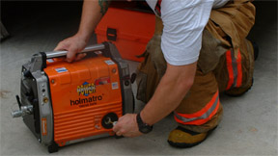
Lesson Two Firefighter II
TERMINAL OBJECTIVE
The Firefighter II candidate shall correctly describe the benefits provided to fire department personnel by the utilization of fire department safety standards and list those safety hazards common to operation of fire department tools and electrical equipment.

Slide 15
Enabling Objectives
The Firefighter II candidate shall correctly define in writing the terms laws and standards.
The Firefighter II candidate shall correctly define in writing the goals and objectives as they pertain to safety policies.
The Firefighter II candidate shall correctly identify in writing how laws and standards impact a fire department's safety program.

Slide 16
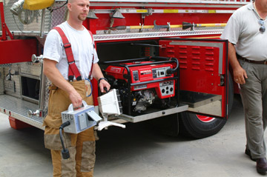
Enabling Objectives
The Firefighter II candidate shall correctly describe in writing the safety procedures to be used for fire service lighting equipment.
The Firefighter II candidate, when given various hand or power tools, shall correctly describe in writing the respective safety hazards presented by each.

Slide 17


Enabling Objectives
The Firefighter II candidate, when given various power tools, shall correctly describe in writing the safety procedures for ensuring various power tools are in a “ready state”.

Slide 18
Laws & Standards
Laws: rules of conduct that are adopted and enforced by an authority having jurisdiction.
Standards: criterion documents that are developed to serve as models or examples of desired performance behaviors.

Slide 19
Safety Policy Goals
Goal - a broad, general, non- measurable statement of desired achievement.
  Prevent human suffering, deaths, injuries, illnesses, and exposures to hazardous atmospheres and contagious diseases.
  Prevent damage / loss of equipment
  Reduce the incidence and severity of accidents and hazardous exposures.

Slide 20
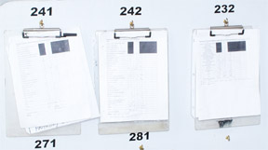
Safety Policy Objective
Objective - a specific, measurable, achievable statement of intended accomplishment.
  Objectives should always include a certain timeframe.

Slide 21
Laws & Standards – Safety Program
N.F.P.A. 1500 Standard on Fire Department Occupational Safety and Health Programs can serve as a guide in establishing objectives for making the fire service a safer place.
N.F.P.A. 1500 is a minimum standard, none of the objectives are intended to restrict a department or jurisdiction from exceeding the requirements specified by the standard.

Slide 22
Laws & Standards – Safety Program
O.S.H.A.s Title 29 of the C.F.R. 1910.120 document involves, as it pertains to a fire departments safety and health program. Ref.: Title 29 of the Code of Federal Regulations (CFR) 1910.120, sub-part L.
1910.120

Slide 23
Lighting Equipment
Fire Department lighting equipment procedures should meet the following:
  Run power plants at least once a week for at least 20 minutes, while powering an electrical device.
  Check fluid levels weekly. Check gas and oil levels after every use. Drain the power plant of all fluids if it is not to be in service for an extended period.

Slide 24
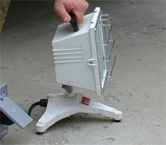
Lighting Equipment
Wear gloves when changing quartz bulbs. Normal hand oil can cause a bulb to explode when it is energized.
Inspect electrical cords at weekly intervals to ensure that the insulation is not damaged.

Slide 25
Lighting Equipment
Procedures:
  Inspect the spark plug, spark plug wire, and carburetor at weekly intervals. A spare spark plug should also be readily accessible.
  Test electrical devices for operating status while the power plant is running.
  Change extra gasoline approximately every three weeks to ensure freshness.

Slide 26
Lighting Equipment
Cords and connectors should meet the following recommendations:
  12-gauge 3-wire type (most common).
  Adequately insulated.
  Waterproof.
  Advantages of twist lock connectors
  Emphasize the importance of utilizing a ground-fault interrupter on any circuit being used at an incident.
  Explosion proof.

Slide 27
Hand & Power Tool Safety
There are numerous fire service hand and power tools.
It is essential that safety be paramount whenever using/operating tools.
Review your fire department’s recommendations (SOPs / SOGs) as well as the manufacturers recommendations for safe use of hand and power tools.

Slide 28
Hand & Power Tool Safety
All tools should be kept in a “ready state”.
  All power equipment should be full of fresh fuel.
  Damaged or dull blades should be replaced or repaired.
  Belts should be checked for correct operating tension and damaged.
  All hose fittings should be clean and clear of obstructions.
  All equipment should be clean and dry.

Slide 29
Hand & Power Tool Safety
Hand and power tools should be maintained and cleaned according to manufacturer recommendations.
Maintenance records should be kept according to departmental SOPs / SOGs. Records should include:
  Damaged equipment.
  Maintenance record.

Slide 30
Review
Review the fact that the firefighter should be familiar with the laws and standards that impact firefighter safety, especially NFPA 1500.
Review the safety considerations for the operation of power plants and lighting systems.
Review the safety hazards associated with the various hand and power tools utilized by the firefighter.

