Slide 1
Technical Rescue General - Rescue Rigging
North Carolina Fire & Rescue Commission
General Rescue Rigging
Updated 12/2011
1

Slide 2
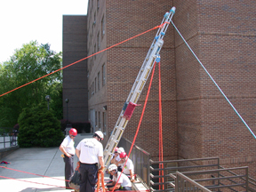
General Rescue Rigging
TERMINAL OBJECTIVE
The Technical Rescuer candidate, when given the appropriate equipment, shall correctly explain the basic construction of rigging used in the technical rescue setting.
2

Slide 3
Enabling Objective
The Technical Rescuer candidate, when given the appropriate equipment, shall correctly identify the basic parts and construction features, shall demonstrate the basic climbing methods of a ladder, and shall demonstrate how to clean and maintain a ladder.
The Technical Rescuer candidate, when given the appropriate equipment, shall correctly demonstrate the construction of a picket system.
3

Slide 4
Enabling Objectives
The Technical Rescuer candidate, when given the appropriate equipment, shall correctly demonstrate the construction of a ladder hinge.
The Technical Rescuer candidate, when given the appropriate equipment, shall correctly demonstrate the construction of a ladder slide.
The Technical Rescuer candidate, when given the appropriate equipment, shall correctly demonstrate the construction of a ladder-as-a-derrick.
4

Slide 5
Enabling Objectives
The Technical Rescuer candidate, when given the appropriate equipment, shall correctly demonstrate the construction of a ladder jib.
The Technical Rescuer candidate, when given the appropriate equipment, shall correctly demonstrate the construction of a ladder A- frame.
The Technical Rescuer candidate, when given the appropriate equipment, shall correctly demonstrate the construction of an A-frame, using timbers.
5

Slide 6
Enabling Objectives
The Technical Rescuer candidate, when given the appropriate equipment, shall correctly demonstrate the construction of a tripod, using timbers.
The Technical Rescuer candidate, when given the appropriate equipment, shall correctly demonstrate the construction of a gin pole, using timbers.
The Technical Rescuer candidate, when given the appropriate equipment, shall correctly demonstrate the construction of a jib arm, using timbers.
6

Slide 7
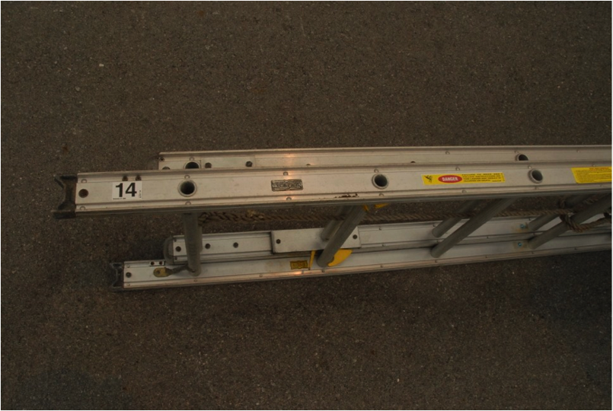
Parts of a Ladder
Beam
7

Slide 8
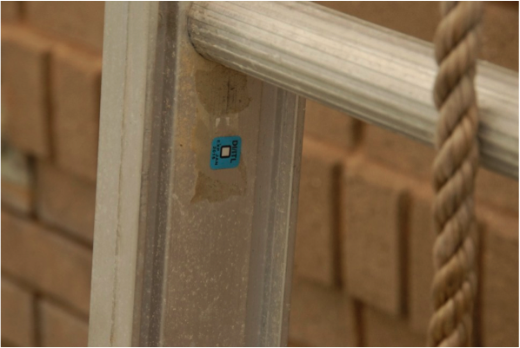
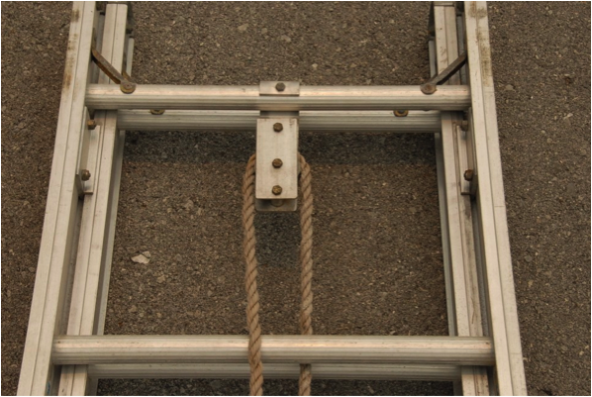
Parts of a Ladder
Rungs
8

Slide 9
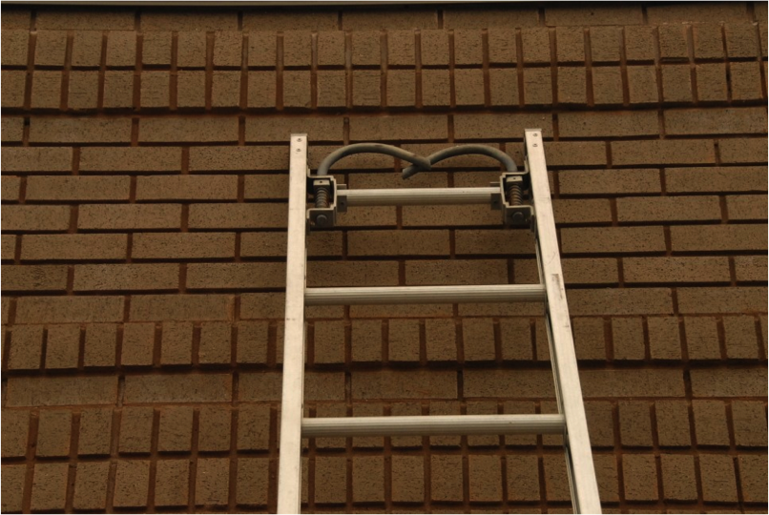
Parts of a Ladder
Tip
9

Slide 10
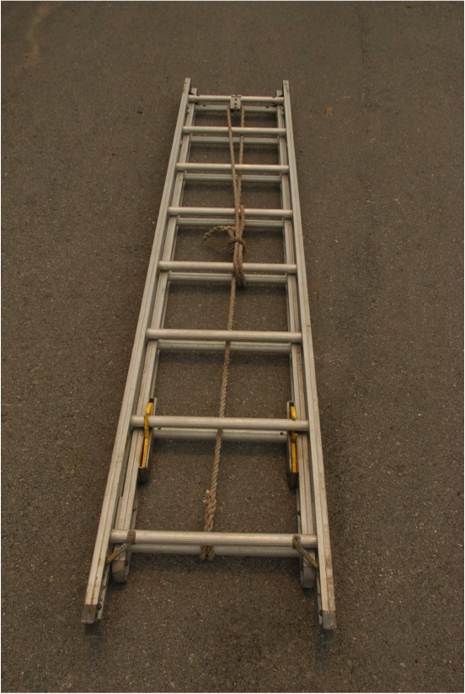
Parts of a Ladder
Butt
10

Slide 11
Parts of a Ladder
Halyard
11

Slide 12
PArts of a Ladder
Hooks
12

Slide 13
Ladder Features
Ladder design characteristics are directly related to the safety considerations for all types of ground ladders.
The three most common types of ground ladders are:
Metal.
Wooden.
Fiberglass.
13

Slide 14
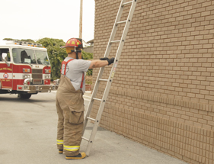
Ladder Load Limits
According to NFPA 1932, Standard for Testing and Maintaining Fire Service Ladders, the working load of a straight wall ladder positioned in an acceptable climbing angle is 750 pounds.
According to NFPA 1932, Standard for Testing and Maintaining Fire Service Ladders, the working load of an extension ladder positioned in an acceptable climbing angle is 750 pounds.
14

Slide 15
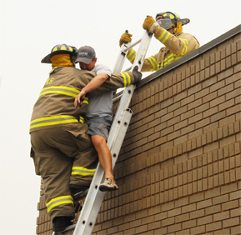
Ladder Load Limits
According to NFPA 1931, Standard for Manufacturer's Design of Fire Department Ground Ladders, all structural components of ground ladders shall be constructed of materials such that the ground ladder maintains at least 75% of the strength necessary to pass all test requirements in this standard at 300°F.
15

Slide 16
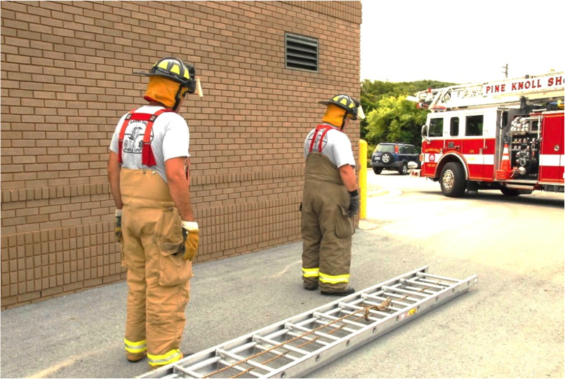
Ladder Carry
Both rescuers position themselves on the same side of the ladder facing the butt end.
16

Slide 17
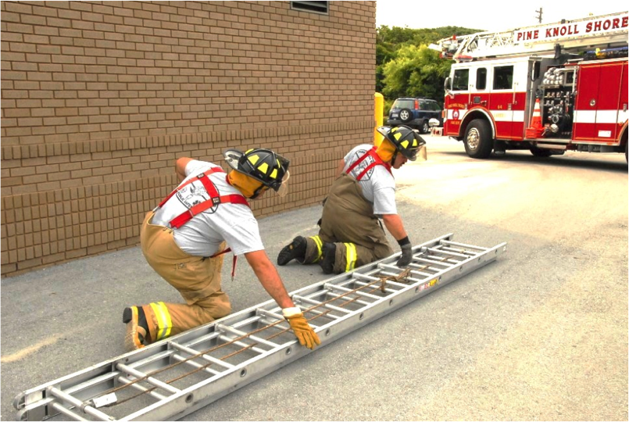
Ladder Carry
Both rescuers shall kneel beside the ladder and reach across the ladder and grasp a far beam.
17

Slide 18
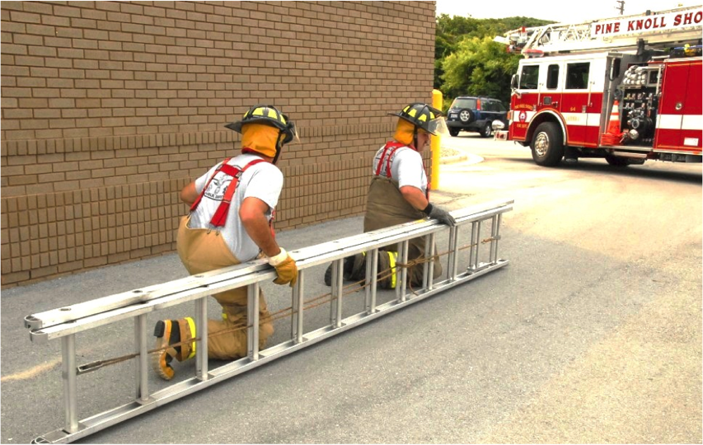
Ladder Carry
The rescuers shall tilt the ladder up so that is resting on the near beam.
18

Slide 19
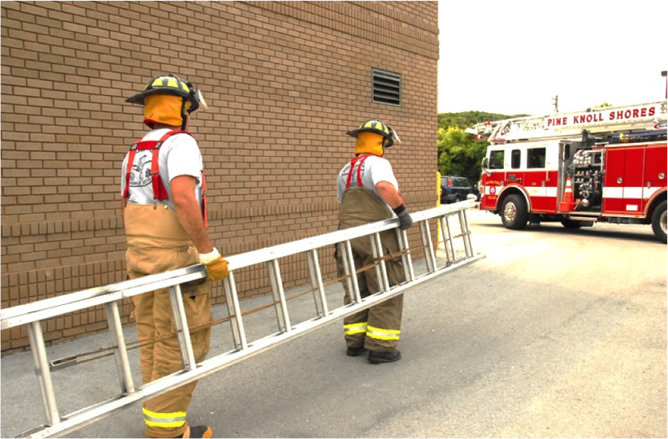
Ladder Carry
Both rescuers shall simultaneously stand positioning the upper beam under the shoulder and carry the ladder to the designated work area, butt end first, and place the ladder flat on the ground with the fly section up.
19

Slide 20
Ladder Raise
The rescuer at the butt end of the ladder shall face the ladder and heel both beams while grasping the nearest rung with both hands.
The rescuer at the tip end shall swing under the ladder and grasp the nearest rung with both hands.
The command "prepare to raise" and "raise" shall be given by the butt end rescuer.
The tip end rescuer shall begin raising the ladder using the hand over hand method.
20

Slide 21
Ladder Raise
As the ladder moves to the vertical position, the butt end rescuer shall continue to grasp rungs higher up on the ladder until the ladder reaches the vertical position.
Both rescuers shall face each other through the ladder and pivot the ladder to the fly out position.
The outside rescuer shall stabilize the ladder while the inside rescuer raises the fly section to the appropriate height.
21

Slide 22
Ladder Raise
Set the ladder at the appropriate climbing angle. When placed in the accepted climbing angle of 75.5 degrees, three rungs should extend above the window sill, roof edge, or parapet wall.
Both rescuers shall verify the pawls are locked securely.
The butt end rescuer shall secure the halyard line by wrapping the halyard line at least a full round turn around two rungs and then securing it by tying off to the upper rung using a clove hitch.
22

Slide 23
Climbing Basics
When climbing, the rescuer should attempt to establish a climbing rhythm so as not to bounce the ladder.
Climbing should be done in the center of the ladder with hands consistently positioned on the rungs.
Exception: when carrying a tool.
Note: Always maintain three points of contact with the ladder!
23

Slide 24
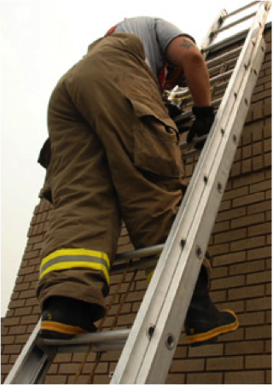
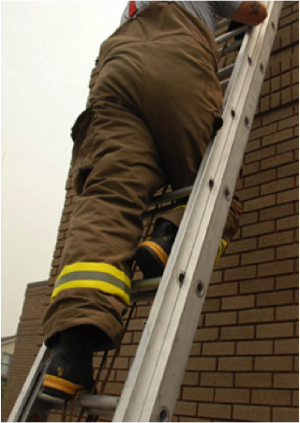
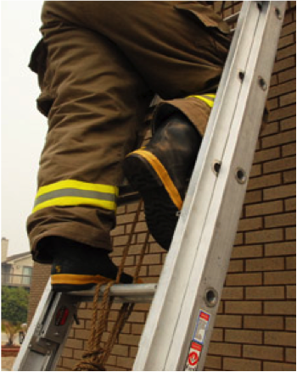
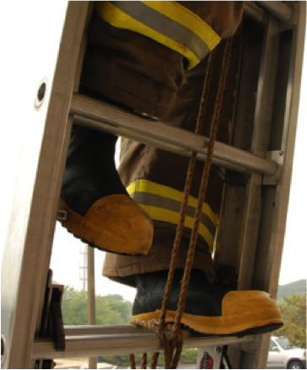
Locking Off
24

Slide 25
Inspection Procedures
Inspection and cleaning should follow NFPA 1932 guidelines.
Check the heat sensor label for discoloration indicating excessive heat exposure. Heat sensors located at various points on the inside of the beams will activate and turn black at 300 degrees.
Check the rungs for snugness and the bolts and rivets for tightness.
Check the welds for cracks or other defects.
25

Slide 26
Inspection Procedures
Check the beams and rungs for cracks, splintering gouges, warping or discoloration.
Check hooks, pawls and halyard for function and damage.
Check halyards for discoloration, cuts and frays. The halyard diameter should be 3/8".
26

Slide 27
Cleaning Procedures
Ladders should be cleaned after each use.
A soft bristle brush and running water is best tool for cleaning.
Approved solvents may be used to remove greasy residue.
27

Slide 28
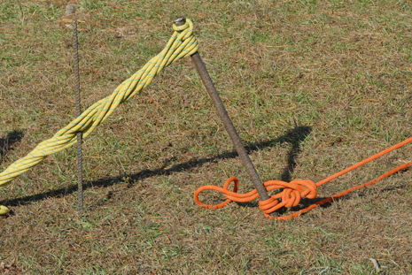
Picket Systems
A picket system is an alternative anchor used in a natural setting such as soil when no other anchors are available.
Soft soils do not accommodate a picket system well.
28

Slide 29
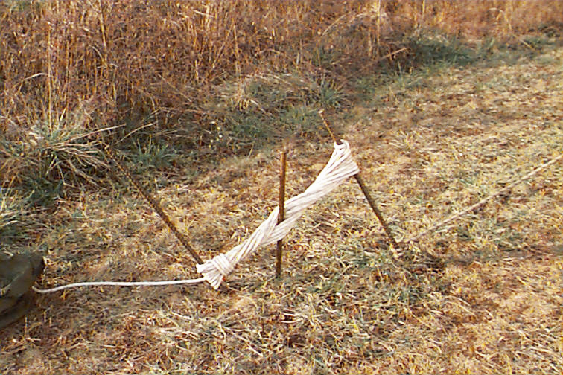
Picket System Set-up
Pickets should be driven into the ground approximately two-thirds their length at an angle of 15 degrees away from the force to be anchored.
When using a combination of pickets, they should be driven into the ground at a distance apart approximately equal to their length. Pickets should never be less than three feet apart.
When using a combination of pickets, they should be lashed together with a 1/2” x 25' - 50’ rope.
29

Slide 30
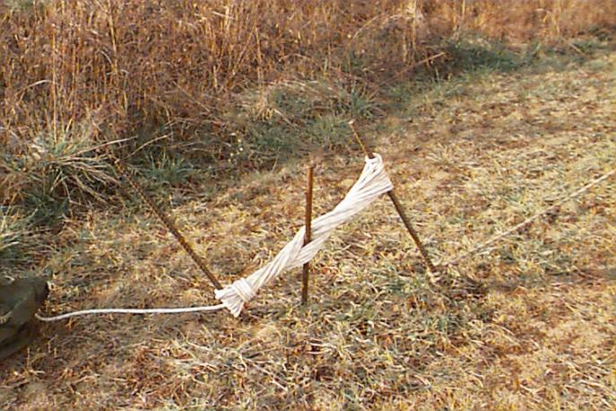
Picket System Set-up
Start the lashing with a clove hitch in the center of the rope near the top of the first picket. Make as many turns as possible around the first and second picket, going from the top of the front picket, or primary anchor to the bottom of the back-up picket, or secondary anchor.
Secure the lashing with two half hitches on the lashing between the two pickets.
30

Slide 31
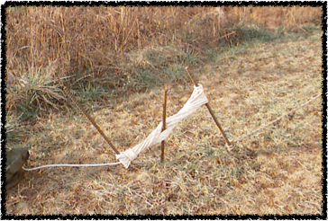
Picket System Set-up
Take a short steel rod for use as a spinner rod with a minimum 2' by 3/8” diameter, and put it through the turns of the lashing rope, twisting until the lashing is tight, and then drive the short picket into the ground.
Use a short piece of PVC pipe with a minimum of 1 1/4” diameter as a buffer between the spinner and the rope.
31

Slide 32
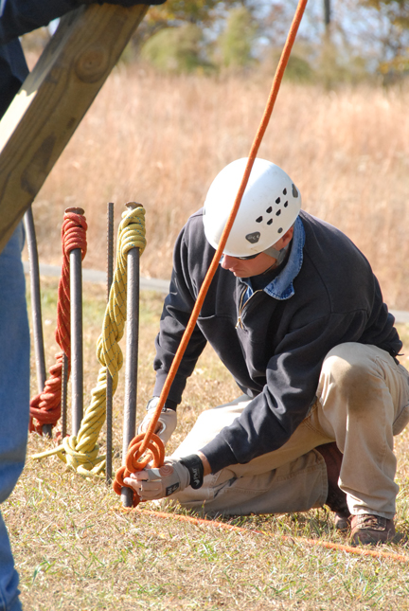
Picket Load Capacity
Single Picket System - 700 pounds.
1:1 Combination - 1400 pounds.
1:1:1 Combination – 2000 pounds.
NOTE: This is the load capacity for systems in average soil. The soil type can add or take away from the total load capacity.
32

Slide 33
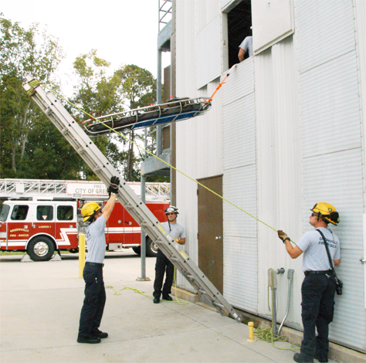
Ladder Hinge
This system can be used as a method of rescue employed when there are patients that may need to be lowered or raised in a horizontal position, or when there are several patients.
33

Slide 34
Ladder Hinge & Basket
The ladder is placed vertically against the wall of a building.
The tip of the ladder should extend two rungs above the opening.
Secure two side guy lines to each beam tip of the ladder with a split-locking clove hitch. Anchor with rescuers on the ground at about a 70 degree angle.
34

Slide 35
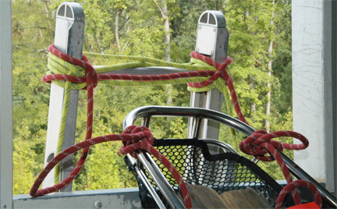
Ladder Hinge & Basket
The foot of the stokes basket is secured to the top of the ladder with a body cord. Leave enough slack to allow the stokes basket to stay in a horizontal position as the ladder is lowered.
Attach a lowering rope to the head of the Stokes basket.
A heel man at the base of the ladder walks back slowly as the ladder is lowered to help keep the ladder stabilized.
35

Slide 36
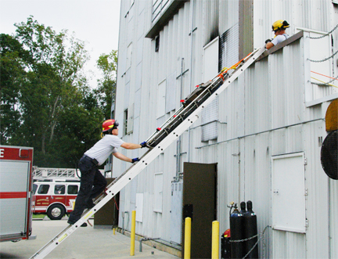
Ladder Slide
This method of rescue can be employed when manpower might be limited, or when there are several patients.
NOTE: Patient’s cannot be lowered or raised in a horizontal position using this technique.
36

Slide 37
Ladder Slide & Basket
The rungs should be secured using clove hitches and round turns at the point where the butt end of the fly section meets the bed section.
Position the ladder so that the tips rest slightly above the windowsill, roof edge or parapet wall. Point out that this is a different tip position than the ladder raise mentioned above,
At the upper level a minimum of three rescuers shall rig the victim into the stokes basket in the same manner as preparing for a vertical lower.
37

Slide 38
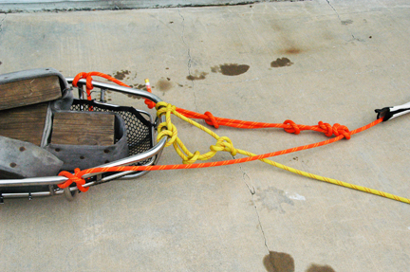
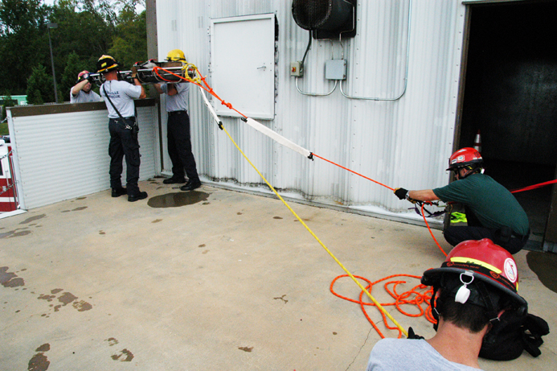
Ladder Slide & Basket
Secure main line and belay line to the stokes basket
using the vertical lowering
method.
Secure both lines to separate anchors and appropriate lowering devices.
38

Slide 39
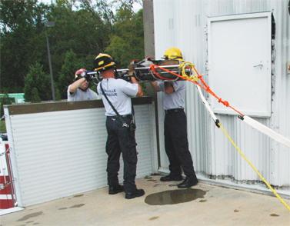
Ladder Slide & Basket
While one rescuer heels the butt end of the ladder, another rescuer shall climb the ladder to a position eye level to the window sill, roof edge or top of parapet wall and lock-off on the ladder until the basket is setting on the edge of the window sill, roof edge or parapet wall.
39

Slide 40
Ladder Slide & Basket
Two rescuers will be needed to pass the victim out to the rescuers on the ladder while a third rescuer controls the main line lowering system.
Once the rescuer on the ladder has secured control of the basket, one of the upper level rescuers will control the belay line while the other rescuer will act as a spotter and safety officer and will be responsible for giving the appropriate lowering commands until the victim and rescuer safely reach the ground.
These are the same commands used for a vertical lowering operation.
40

Slide 41
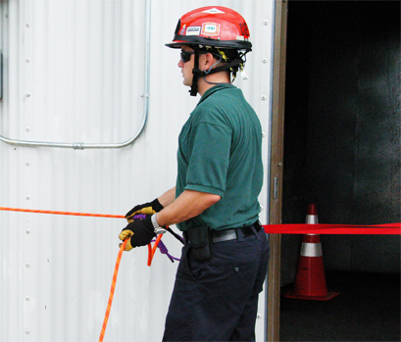
Ladder Slide & Basket
Appropriate friction devices, or other suitable means should be used when lowering the patient to keep the weight of the patient off the person on the ladder.
41

Slide 42
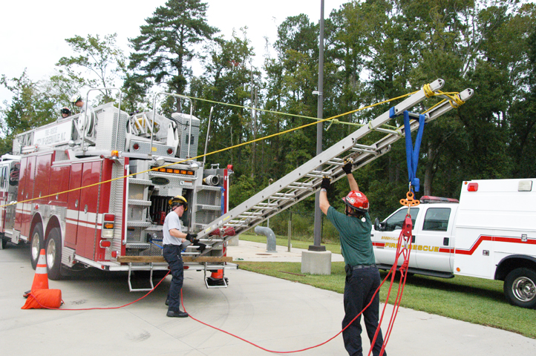
Ladder-as-a-Derrick
The ladder-as-a-derrick can be used to lift weights, or used for lowering or raising patients being rescued.
It is a very effective method of rescue when the patient needs to be lowered or raised in a horizontal position.
42

Slide 43
Ladder-as-a-Derrick
The aft guy line and side guy lines should be one and one-half to two times the length the ladder is extended, never less than the length. The holdfast or picket anchoring system should be placed forward of the base of the ladder in line with the object being lifted.
NOTE: A thirty-five foot three-section ladder may be used in place of the more commonly used 24' foot extension ladder.
If a three-section ladder is used for this procedure, then both fly sections should be secured to one another using round lashing around the rungs or beams, as well as the bed being secured to the first fly section at one or more points.
43

Slide 44
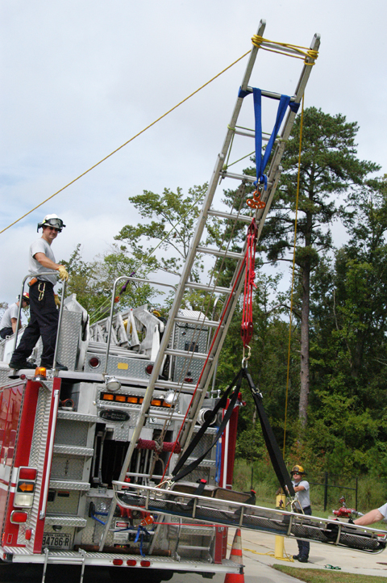
Ladder-as-a-Derrick
Attaching side guys using two ropes.
Secure a split locking clove hitch on each beam at the top rung of the ladder, then cross over to the opposite beam and secure a loop over them. The side guys should be tied at the first rung.
44

Slide 45
Ladder-as-a-Derrick
Attaching side guys using a single rope.
Form a bight in the middle of the rope and slip it under the first rung and back over the beams.
At each beam form a half hitch and slip it over the top of each beam thus forming a split clove hitch.
Take each leg of the rope to the opposite beam, form a loop and slip them over each beam.
45

Slide 46
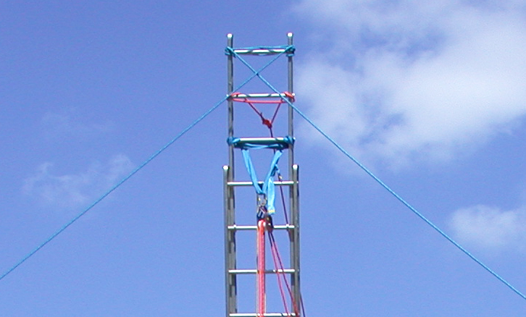
Ladder-as-a-Derrick
Constructing the aft guy.
Take the standing part of the rope and the remaining running to a point equal to an arm’s length above the second rung and tie a self-adjusting bowline with a safety knot.
46

Slide 47
Ladder-as-a-Derrick
Attaching the anchor sling for the upper pulley.
A rope sling or tubular nylon sling rated for the load; place the sling across the beams just below the third rung.
Bring each leg of the sling around each respective beam and over the top of the third rung and center up each leg and secure the upper pulley to the sling with a locking carabiner.
47

Slide 48
Ladder-as-a-Derrick
Safety Precautions.
The manufacturer’s specifications and guidelines should be referred to regarding the maximum load that can safely be placed on the system.
All loads should remain within the beams of the ladder. This system will not accept side loading.
The higher the load is raised, the more the load is increased on the system.
Using a change of direction pulley at the base of the ladder will allow the haul line to be pulled in such a manner that forces the base of the ladder into the ground.
48

Slide 49
Ladder-as-a-Derrick
Setting up on the back of a truck.
The main difference in setting up a ladder-as-a-derrick on the tailboard of a vehicle as opposed to setting one up that is free-standing is the distance that the guy lines are secured in relation to the length the ladder is extended.
The guideline of having the length of the aft and side guy lines a minimum that the length the ladder is extended may differ based upon the length and width of the vehicle being used.
49

Slide 50
Ladder-as-a-Derrick
Setting up on the back of a truck.
When using a fire truck, the side guy lines can secured to the booster line reel or other appropriate anchor. If the aft guy line will not crush the light bar located on the cab of the vehicle, then it may be secured to the front bumper or other suitable anchor on the chassis of the vehicle.
If the aft guy line will not crush the light bar located on the cab of the vehicle, then it may be secured to the front bumper or other suitable anchor on the chassis of the vehicle.
The manner in which the base of the ladder is secured is based upon what is available at the tailboard of the particular vehicle being used.
50

Slide 51
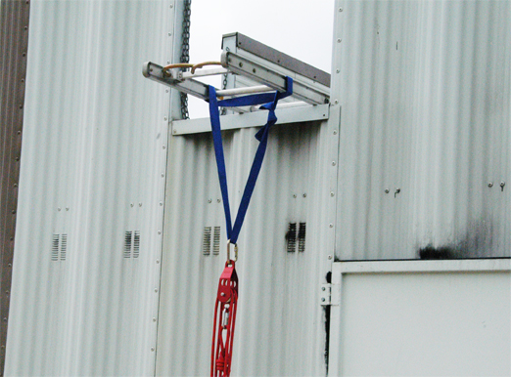
Ladder Jib
When lowering a patient from a collapse, the jib is for a one-person load (300 lbs) only.
Only one rung extends beyond the wall.
A counterweight at the butt end should be used, such as lashing the butt end to an anchor point, or have two rescuers sit on butt end of ladder.
51

Slide 52
Ladder Jib
The ladder is raised to a level above the departure point using standard departmental procedures.
The ladder is positioned in such a manner that the tip of the ladder is higher than the base.
The beams of the ladder should be supported near the tip by the windowsill or parapet wall.
A rope sling or tubular nylon sling is doubled and laid across the ladder at the first rung in such a way that both ends of the sling come through the ladder and rest on the sling as it crosses the ladder.
52

Slide 53
Ladder Jib
Do not place the ladder sling farther than one rung from the parapet wall or windowsill. Each additional inch of projection increases the counterweight required at the base of the ladder.
The bed of the ladder is secured to the fly section at one or more points with round lashing to prevent a separation of the two sections under a load.
A mechanical advantage system is then secured at the sling to create a mechanical advantage.
53

Slide 54
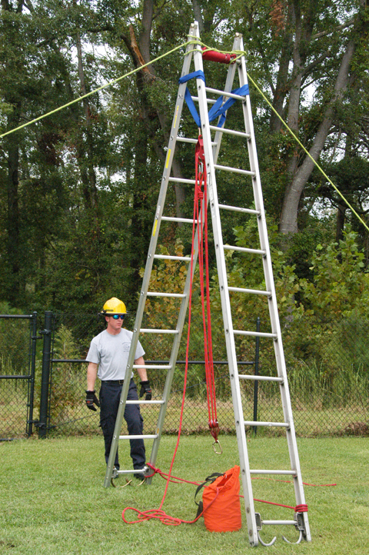
Ladder A-Frame
Position the two ladders on the ground on their beams with the heels of the ladder even.
Align the top rungs of the ladder.
With the top rungs and beams together, keep the butts of the ladder apart equal to approximately one-half the distance from the heel of the ladder to the sling used to support the pulley system.
54

Slide 55
Ladder A-Frame
Lash the top rungs or beams together using round lashing. Clove hitch-round turns-clove hitch.
The two side guy lines are put on with a split clove hitch around the first rung and beam of the ladder with a loop being placed on the opposite beam and the side guy line being secured to a holdfast on that side of the ladder A-frame pulling the beams of the ladder together rather than apart.
The side guy lines should be one and one-half times the distance from the sling at the top of the ladder to the butts of the ladders.
55

Slide 56
Ladder A-Frame
The holdfast or picket anchoring system should be placed in line with the object being lifted.
A rope sling or tubular nylon sling is passed around the beams of one ladder and over the top rung of the connecting ladder so that it rests over the top rungs of the two ladders.
A mechanical advantage system is then secured at this sling to create a mechanical advantage.
The ladders are now ready to be raised over the point of the operation.
56

Slide 57
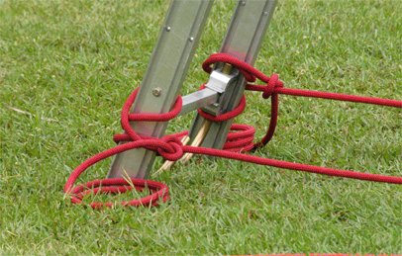
Ladder A-Frame
To prevent the ladders from spreading further at the base, a rope ledger is attached at the bottom rungs of the two ladders.
57

Slide 58
Ladder A-Frame
Rope Ledger
Tie a split clove hitch around the beam and bottom rung of one ladder and secure this rope to the beam and bottom rung of the second ladder with a round turn and two half hitches.
Tie a second rope ledger on the opposite side of the two ladders using the same step described above. Pickets can be used in place of a rope ledger.
58

Slide 59
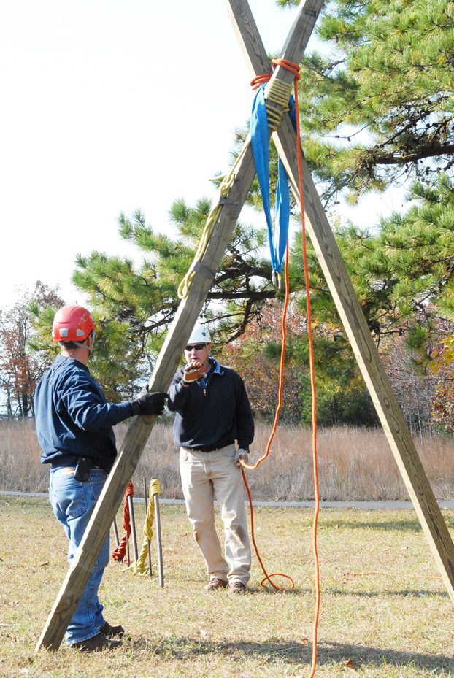
Timber A-Frame
Timber A-frames are used to lift relatively heavy loads where the use of gin poles is impractical.
They can only be used to move a weight in a straight line between the timbers.
They consist of two timbers with their butts on the ground and the tops lashed together with round lashing.
The minimum dimension of lumber required for the A-frame is a 4” x 4” x 12’ timber.
59

Slide 60
Timber A-Frame
Round Lashing.
Select two 4” x 4” x 12’ timbers, even the butts and put 2” x 2” x 24” spacers between the poles near the top and bottom of the timbers, tie the timbers together near the base with a draw-hitch.
Start with a clove hitch approximately 24" to 36” down from the tip of the shortest timber and marry the ends. Be sure to chamfer, or notch the area where the lashing is to be secured.
Continue with six close round turns around both timbers traveling upward.
Make two frapping turns between the two timbers, draw tight, and finish with a clove hitch on the opposite timber from where you started at the bottom of the lashing.
60

Slide 61
Timber A-Frame
Round Lashing.
The round turns should be counted on the outside timber, then return to the nearest timber where the first clove hitch was tied before starting the frapping turns on an A-frame.
To reduce the risk of the lashing from slipping when loaded, 2 wedges can be driven under the lashing from the bottom of each side, or 2" x 4" blocks can be nailed at the bottom of the lashing on each side.
Cross the timbers and spread them 1/3 the distance between the bottom of the lashing and the butt ends.
61

Slide 62
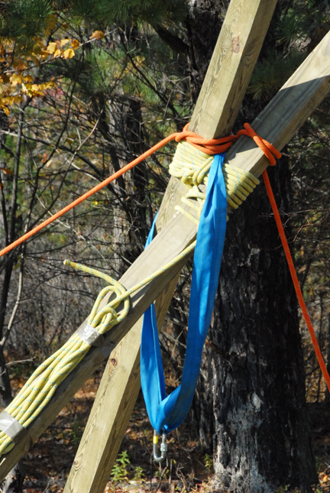
Timber A-Frame
A 2” x 6’ tubular nylon sling is passed over the crotch at the top so that it will rest across the timbers and not on the lashing. This is the anchor sling for the tackle system.
62

Slide 63
Timber A-Frame
To prevent the timbers from spreading further, a board ledger can be used to lash the legs using square lashing.
An alternate method to prevent the timbers from spreading further is to use a 1/2” x 20’ kernmantle rope ledger. Start with a clove hitch and safety knot on the first timber. Go to the second timber and tie a round turn and two half hitches.
63

Slide 64
Timber A-Frame
An alternate method of opening a 2” x 6’ tubular nylon sling and pass it over both timbers at the top. Take a loop of the sling down through the timbers above the lashing, and pull a loop up through the timbers above the lashing.
Take these two loops down and around the timbers below the lashing so that they pull the timbers together.
64

Slide 65
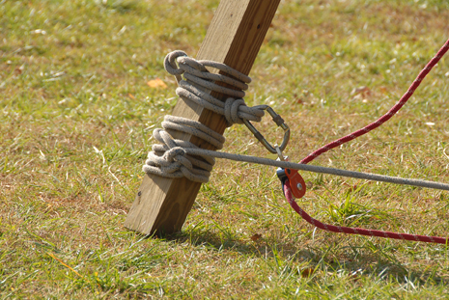
Timber A-Frame
A mechanical advantage system is then secured at this sling to create a mechanical advantage.
A change of direction sling is lashed near the ground of one pole.
Attach the change of direction pulley with the fall line being in the direction of the opposite timber.
65

Slide 66
Timber A-Frame
Setting up a fore and aft guy line.
A-frames are held upright by a two guy lines, fore and aft, forming an inverted “V.”
Tie a clove hitch in the center of the rope and place it over the top of one timber, as close to the lashing as possible. The rope should be long enough to provide a length of 1 1/2 to 2 times the height of the timbers for the guy lines and made of 1/2" kernmantle rope. The clove hitch should pull from the inside of the timber.
66

Slide 67
Timber A-Frame
Form another clove hitch and place it on the other timber in the same manner. The guy lines must be put on so that they draw the timbers together when the load is applied. Example: The forward guy line is fastened to the rear timber while the aft guy line is fastened to the front timber.
The fore and aft guy lines are secured to a solid anchor or picket anchoring system with a round turn and two half hitches or other form of brake control after the desired luff has been obtained.
67

Slide 68
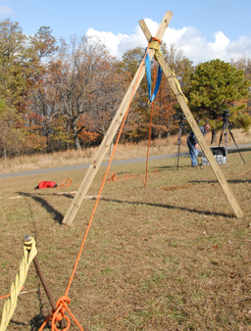
Timber A-Frame
The anchor points for the guy lines should be one and one-half to two times the length of the A-frame, never less than the length.
The anchor point is placed in
line with the object to be lifted.
68

Slide 69
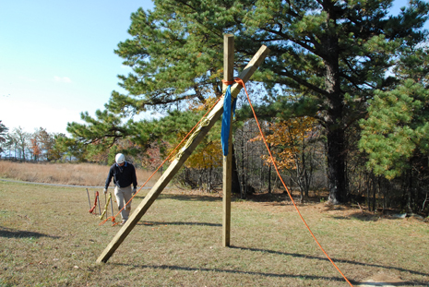
Timber A-Frame
The initial luff should not be over one-fifth the distance between the butt ends and the top lashing on the A-frame, while the maximum luff should not be over one-third the distance between the butt ends and the top lashing of the A-frame.
69

Slide 70
Timber A-Frame
Setting up a change of direction pulley at the base of the A-frame.
The fall line should be pulled in the same direction as the initial luff. This will cause the base of the timbers to dig in rather than slip.
70

Slide 71
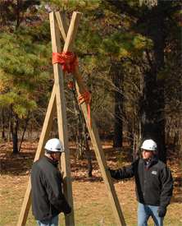
Timber Tripod
A tripod is used to lift loads heavier than those that can be handled by a gin pole or A-frame.
Tripods have three legs and do not require the use of guy lines.
Tripods are designed to lift loads vertically.
The minimum dimensions
for the timber are
4" x 4” x 12’ long.
71

Slide 72
Timber Tripod
Select three 4" x 4” x 12’ timbers and align the butt ends. Place 2" x 4" x 24” spacers between the timbers near the top and bottom of the timbers.
Tie the timbers together near the base with a draw-hitch.
Start with a clove hitch approximately 24” to 36” down from the tip of the shortest timber and marry the ends, be sure to chamfer by notching the area where the lashing is to be secured.
72

Slide 73
Timber Tripod
Next take the rope over and under the three timbers in a figure-of-eight fashion. Make at least six turns, working upward.
Then make two frapping turns between the first and second timber, and two frapping turns between the second and third timber.
Finish off with a clove hitch on the outside timber below the lashing. The remainder of the rope can be coiled around the outside timber.
73

Slide 74
Timber Tripod
After the figure-of-eight lashing is complete, raise the center timber and cross the outer timbers until their butts are at a distance apart equal to approximately one-half the distance between the butt end and the top lashing on the timbers from lashing to the base of the timbers.
The timbers are set to form an equilateral triangle.
74

Slide 75
Timber Tripod
Attaching the primary sling to the crotch of the tripod and the secondary change of direction pulley at the base of one leg of the tripod.
Using a 6' long webbing sling rated for 6000 pounds (carabiner should be large enough to accommodate the width of the web sling).
Open the nylon sling and pass it over the outside timbers at the top.
Take a bight of the sling down through one side of the center timber above the lashing and pull a bight up through the other side of the center timber above the lashing.
Take these two bights down and around the timbers below the lashing so that they pull the timbers together.
75

Slide 76
Timber Tripod
Attaching the primary sling to the crotch of the tripod and the secondary change of direction pulley at the base of one leg of the tripod.
Secure a selected hauling system to the sling.
Secure an appropriate anchor sling system to the bottom of one leg of the tripod so it does not slip up when loaded; creating a secondary change of direction point. A wedge or 2" x 4" block can be attached above the sling to prevent slippage.
The direction of pull through the secondary change of direction pulley shall be towards the opposite leg of the tripod.
A mechanical advantage system is then secured at this sling to create a mechanical advantage.
76

Slide 77
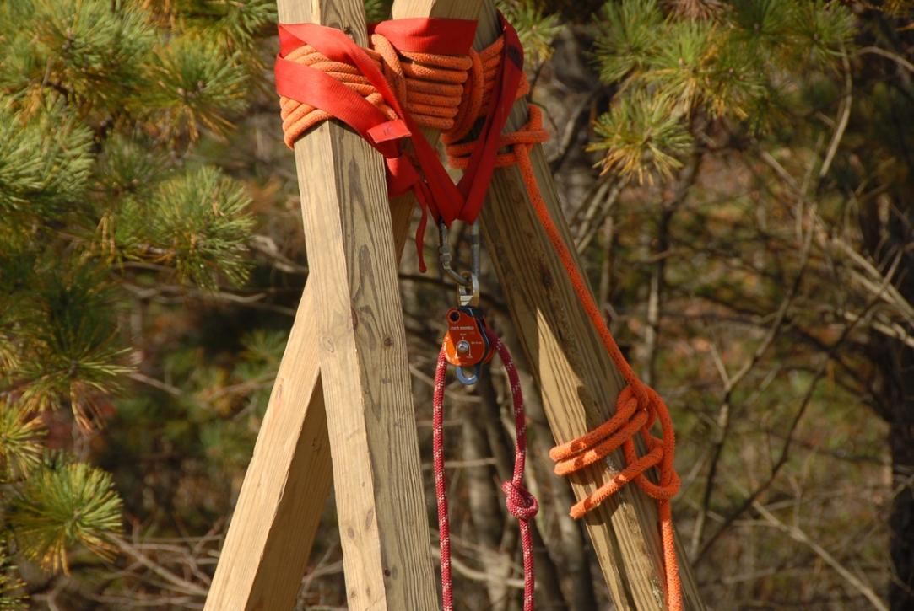
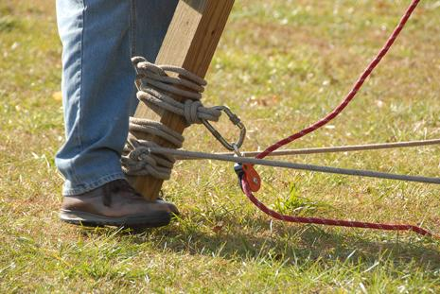
Timber Tripod
Sling & change of direction pulley.
77

Slide 78
Timber Tripod
Securing the base of the tripod.
Secure the butt ends to prevent kick-out using a rope ledger by tying a clove hitch with safety knot or other suitable hitch near the bottom of one timber and round turns to the remaining two timbers then tie off back at the original timber or secure the butt ends by lashing them to pickets.
The base of the tripod may be set in shallow holes for added stability, it may also be necessary to set the base of the tripod on bearing plates.
78

Slide 79
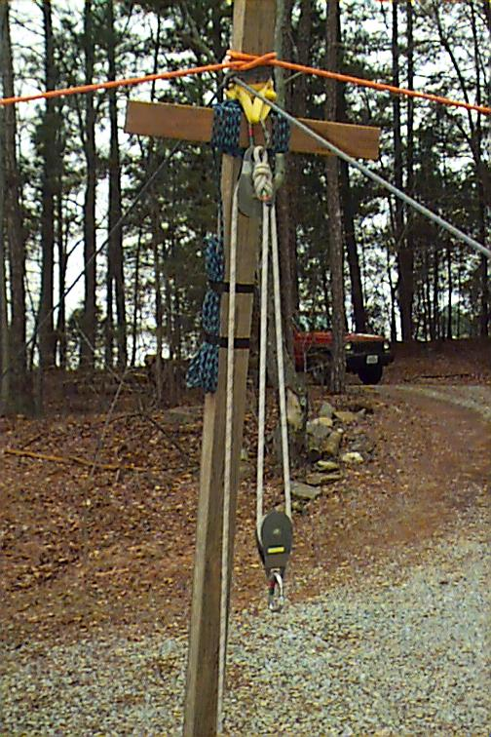
Timber Gin Pole
A gin pole allows the object being lifted to be moved to the left or right, in addition to the front and rear.
Gin poles consist of one timber or two timbers lashed together for strength with the top supported by the use of four guy lines.
Square lashing is used to hold two timbers together that cross at right angles.
79

Slide 80
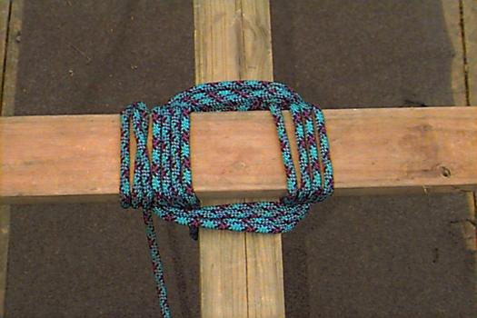
Timber Gin Pole
Select one 4" x 4” x 12’ timber, or a 6” x 6” x 12’ timber.
Lay a 2" x 4” x 24” board
or ledger at a right angle to the timber
approximately 18” from
the top.
Using a 1/2" x 50’ kernmantle rope, start with a clove hitch around the timber below the ledger and marry the running end to the standing part. Then take the married ends up and around both the timber and ledger.
80

Slide 81
Timber Gin Pole
Repeat this lashing four times inside on the timber and outside on the ledger; drawing the rope as tight as possible.
Take four frapping turns around the whole lashing between the timber and the ledger.
Draw tight and finish with a clove hitch on the ledger.
81

Slide 82
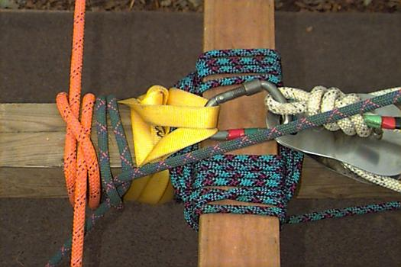
Timber Gin Pole
After the square lashing is complete, a change of direction sling is lashed so the upper block will be suspended over the ledger.
Place the base of the gin
pole where it is to be
erected.
Place the guy lines on
the gin pole using 1/2" kernmantle rope.
The rope should be long enough to provide a length of 1 1/2 to 2 times the height of the timbers for the guy lines.
82

Slide 83
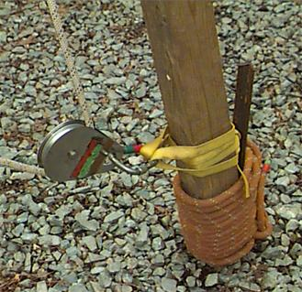
Timber Gin Pole
The distance of the guy line between the top of the gin pole and the bottom of the ledger should be 1 1/2 to 2 times the distance between the butt end and the bottom of the ledger.
For the base of the gin pole,
dig a hole 6” to 12” deep,
depending on the soil, and
the weight to be lifted. If the
ground is soft, use boards
to make a bearing plate for the gin pole.
A picket holdfast may be used to keep the base of the gin pole from slipping.
83

Slide 84
Timber Gin Pole
Set up the picket holdfast approximately three feet from the base of the gin pole, and tie a rope from the base of the gin pole to the picket.
This holdfast will keep the gin
pole from skidding while
being raised and it will hold it
in place while lifting; or
loosely lash a picket to the
base of the pole and create
a snatch block sling for the
change of direction pulley.
84

Slide 85
Timber Gin Pole
The initial luff should not be over one-fifth the height of the gin pole while the maximum luff should not be over one-third the height of the gin pole.
The side guy lines and the fore and aft guy lines are secured to a holdfast or picket anchoring system with a round turn and two half hitches after the desired luff has been obtained.
85

Slide 86
Timber Gin Pole
A change of direction sling is lashed near the ground of the gin pole.
Secure an appropriate anchor sling system to the bottom of the gin pole so it does not slip up when loaded, creating a secondary change of direction point, a wedge or 2" x 4" block can be attached above the sling to prevent slippage.
Attach the change of direction pulley with the fall line being hauled in the same direction as the initial luff, this will cause the base of the gin pole to dig in, rather than slip.
86

Slide 87
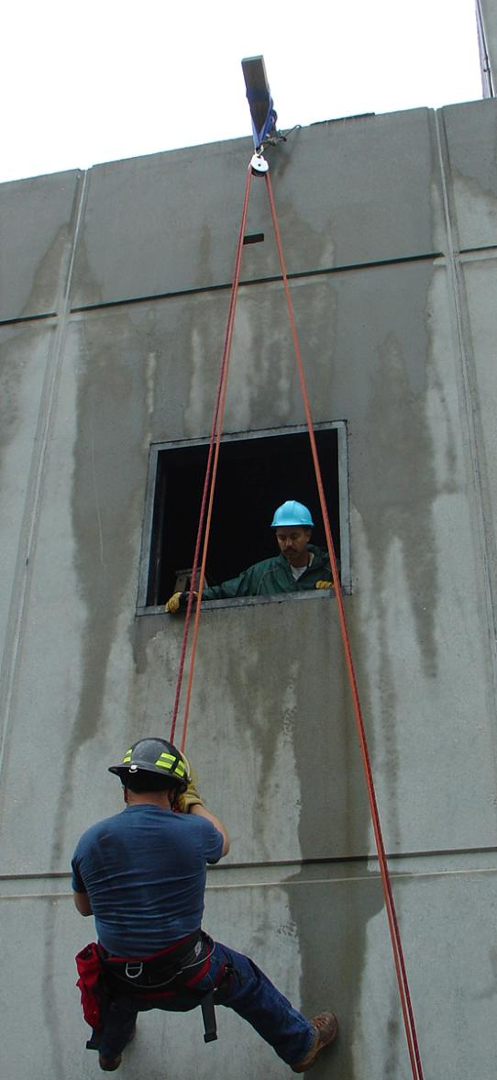
Timber Jib Arm
Constructing a timber jib arm.
One end is anchored down and the other end projects over a support no more than 12” to 18”.
This system allows objects to be lowered or raised using a mechanical advantage system capable of controlling the load.
87

Slide 88
Timber Jib Arm
The actual method of supporting or arranging the jib arm depends on the condition under which it is erected.
It may be projected over a windowsill, resting on a piece of timber to distribute the load, with the jib arm kept in position by pads, or blocks at either side.
The jib arm may be supported on an A-frame.
88

Slide 89
Timber Jib Arm
In all cases safety must be observed both in respect to the jib arm itself and the structure from which the rigging derives its support; especially where buildings have been damaged.
A sound windowsill does not necessarily mean that there is a sound wall beneath the windowsill.
The tail of the jib should be lashed down with round lashing or square lashing, according to the facilities available.
89

Slide 90
Timber Jib Arm
If necessary, floorboards should be ripped up to allow the tail to be lashed. If it is not practical to lash down the jib arm, debris, or heavy objects can be placed on the tail to act as a counterbalance for the weight being lifted.
It is important that the jib not be projected out over the wall any more than necessary.
Each additional inch of projection increases the leverage on the tail counterbalance.
90

Slide 91
Timber Jib Arm
When possible, the jib arm should be erected above the floor from which you are working.
As an additional safety measure, a rope should pass through the pulley system and anchored to a secure point in the event that the jib arm should fail, the load does not go to the ground.
91

Slide 92
Timber Jib Arm
Select one 4" x 4” x 12’ timber, or 6" x 6” x 12’ timber. If one timber is not strong enough, lash two timbers together.
Use a 2” x 6’ tubular nylon sling close to the end of the jib arm.
Attach the selected hauling system or change of direction in the sling.
92

Slide 93
Summary
This lesson plan explains constructing and using ground ladders and timbers to construct anchors and anchoring systems commonly used in high and low angle rescue operations.
It is imperative the Technical Rescuer candidate identify suitable anchor points, determine the construction of anchor materials, and understand the stress loads applied to anchor systems.
93

Slide 94
Summary
The Technical Rescuer candidate will be called upon to incorporate many or perhaps all of these anchoring systems into the various rescue operations they will encounter. They must become proficient in each one. After all, the entire rescue operation may well hang on the ability of the Technical Rescuer candidate to select and rig a safe anchor or anchoring system.
94

